Slide 1
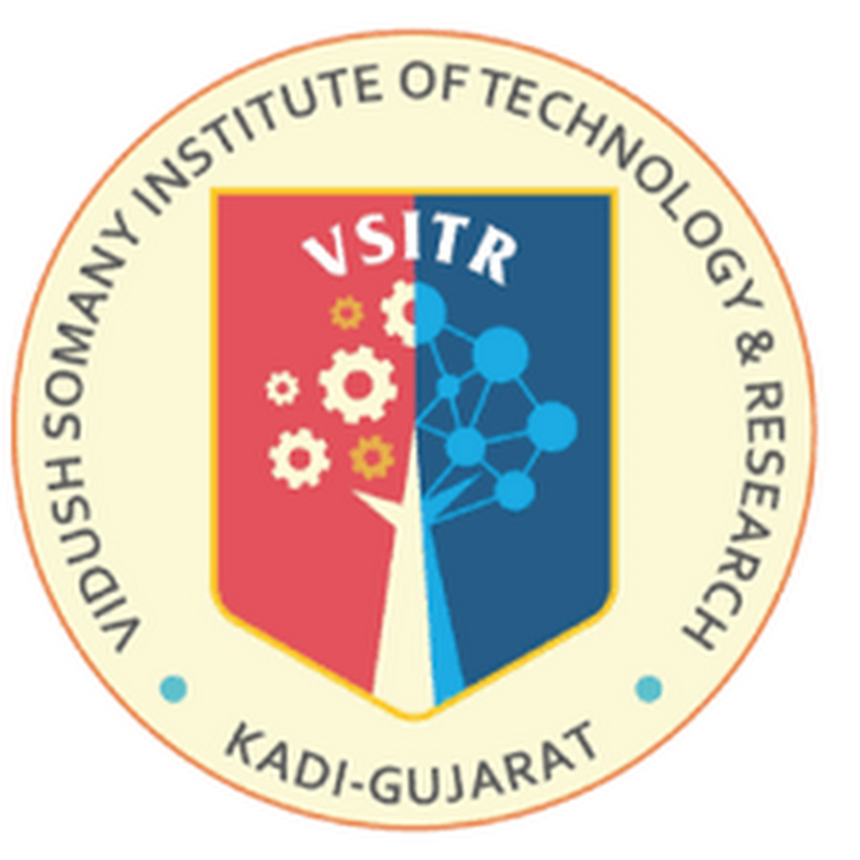

Green Technology in Construction: Building a Sustainable Future
6th Semester
CT607-N Seminar
Computer Engineering
Group No: 02
Internal Guide:
Prof. Krupali Dave
Prepared By:
Patel Dhyan Jayeshkumar (223SBECE54021)
Patel Shreyaben Hemendrakumar (223SBECE54032)
Patel Vaishvi Kamleshkumar (223SBECE54033)
Satasiya Bansari Rakeshbhai (223SBECE54038)

Slide 2
Outlines
Introduction
Problem Statement
Objective
Scope
Possible Outcomes
Prior Art Search (Literature review)
Flowchart
E-R Diagram
DFD Diagram
Conclusion & Future Works
References

Slide 3
1.INTRODUCTION
The construction industry plays a key role in global development but has often been linked to high resource use and environmental damage. However, with green technology, the industry is changing by focusing on sustainability, efficiency, and caring for the environment.
Green technology in construction means using new methods, materials, and practices that lower environmental harm while improving how buildings work. This includes energy-saving designs, renewable energy, and other eco-friendly solutions to create buildings that are better for the planet, more affordable, and built for the future.
With issues like climate change and limited resources, adopting green technology isn’t just a choice—it’s a necessity. It helps ensure that we can grow and develop today without harming the ability of future generations to live and succeed.

Slide 4
2. Problem Statement
The construction industry's current practices result in unsustainable resource use, high greenhouse gas emissions, and significant waste generation. To tackle these issues, innovative green technologies must be adopted to reduce the environmental impact while ensuring energy efficiency, affordability, and sustainability in construction.

Slide 5
3. Objective
To revolutionize the construction industry by embedding green technology that transforms how we build—focusing on reducing environmental harm, optimizing resource efficiency, and enhancing energy performance. The ultimate aim is to create structures that are not only sustainable and eco-friendly but also cost-effective and resilient, ensuring a balance between development and environmental stewardship for a greener future.

Slide 6
4. Scope
The scope of green technology in construction is vast and transformative, covering multiple aspects of the industry.
Eco-Friendly Materials: Promoting the use of sustainable, recyclable, and low-carbon materials to reduce the environmental footprint.
Energy Efficiency: Implementing energy-efficient designs, smart technologies, and renewable energy systems like solar panels and wind energy to minimize energy consumption.
Water Conservation: Integrating systems like rainwater harvesting and water recycling to reduce water usage in construction and operations.
Waste Reduction: Encouraging recycling and reuse of construction waste to minimize landfill impact and improve resource efficiency.
Smart Technologies: Utilizing advanced technologies like Building Information Modeling (BIM), smart sensors, and automation for optimized construction processes and efficient resource use.
Sustainable Urban Planning: Supporting green building certifications (e.g., LEED, BREEAM) and promoting sustainable communities through eco-friendly infrastructure.

Slide 7
5. Possible Outcomes
Reduced Environmental Impact: Significant reduction in greenhouse gas emissions, energy consumption, and resource depletion through the adoption of green construction practices.
Cost Efficiency: Long-term savings for builders and occupants through lower energy bills, reduced maintenance costs, and efficient resource utilization.
Enhanced Building Performance: Improved energy efficiency, better indoor air quality, and overall healthier living and working environments.
Waste Minimization: Reduction in construction and demolition waste by implementing recycling, reuse, and sustainable materials.
Increased Adoption of Renewable Energy: Wider integration of renewable energy systems like solar panels and wind energy in building designs.
Sustainable Urban Development: Creation of eco-friendly buildings and infrastructure that contribute to smarter, greener cities.
Global Environmental Benefits: Contribution to combating climate change and achieving international sustainability goals, such as those outlined in the United Nations Sustainable Development Goals (SDGs).

Slide 8
6. Prior Art Search
Area of Research | Existing Solutions | Technologies/Methods
Energy-Efficient Building Materials | Advanced insulation materials (e.g., hempcrete, cellulose) | Eco-friendly concrete, aerogels, reflective coatings for heat insulation
Renewable Energy Integration | Solar panels, wind turbines integrated into building designs | Photovoltaic cells, solar roofs, geothermal heating/cooling systems
Building Information Modeling (BIM) | BIM used to optimize designs and reduce resource waste | Software tools for energy simulations, waste management, and environmental performance monitoring
Water Conservation Technologies | Rainwater harvesting systems, low-flow plumbing fixtures | Greywater recycling systems, efficient irrigation, smart water metering
Waste Reduction and Circular Economy | Recycled construction materials (steel, plastic, glass) | Modular construction, waste management systems, material reuse and recycling methods
Smart Technologies in Construction | IoT and AI integration for energy management | Smart thermostats, energy management systems, automated lighting, and predictive maintenance technology
Sustainable Urban Planning | Green buildings, green roofs, and urban farming | Green transportation networks, eco-friendly public spaces, mixed-use buildings

Slide 9
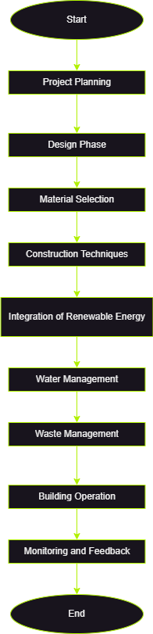
7. Flowchart

Slide 10
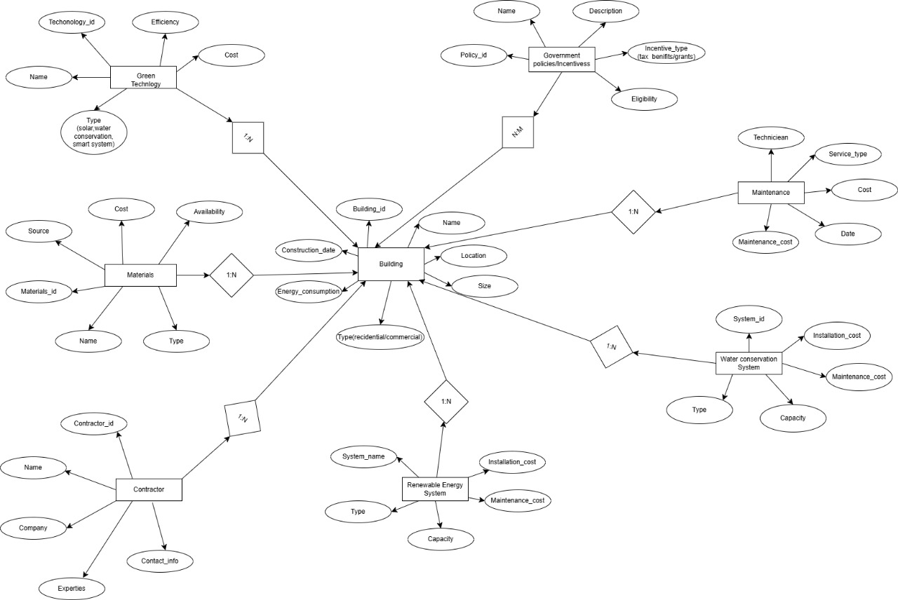
8. E-R Diagram

Slide 11
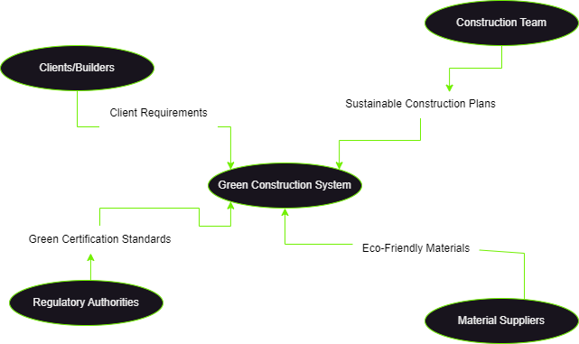
9. DFD Diagram (Level 0)

Slide 12
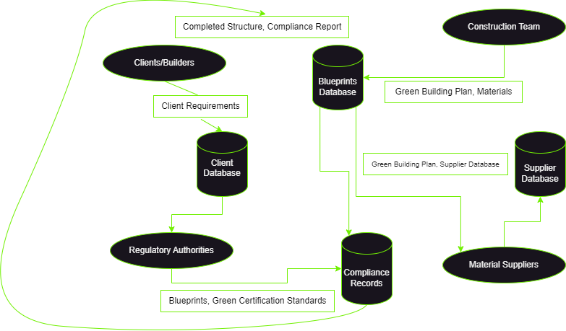
9. DFD Diagram (Level 1)

Slide 13
10. Conclusion & Future Works
Conclusion
Green technology in construction is essential for reducing environmental impact, improving energy efficiency, and promoting sustainability. While significant advancements have been made, challenges like high initial costs and limited material availability remain. Adopting these technologies leads to long-term benefits, including reduced energy consumption, lower costs, and healthier environments.
Future Works
Develop affordable, efficient green materials and renewable energy systems.
Strengthen government incentives and regulations to promote green technologies.
Provide education and training to build a skilled workforce.
Foster global collaboration and share best practices in green construction.
Create metrics to measure the long-term impact of green technologies.

Slide 14
11. References
UNEP. (United Nations Environment Programme) (2019). Global Status Report for Buildings and Construction 2019.
IEA. International Energy Agency (2020). Energy Efficiency in Buildings.
USGBC. U.S. Green Building Council (2020). LEED v4 for Building Design and Construction.
LEED v4 (Leadership in Energy and Environmental Design (v4 refers to version 4 of the standard))
World Green Building Council. (2018). The Business Case for Green Building.
BRE. Building Research Establishment (2014).
BREEAM – Sustainability Assessment Method. BREEAM
ChatGPT

